Slide 1
SONA COLLEGE OF TECHNOLOGY DEPARTMENT OF COMPUTER SCIENCE AND ENGINEERING
Final Year Project Presentation 2021-2022
Presented By:
Manikandan M (1518102069)
Pankaj Kushwaha (1518102090)
Sethu Madhavan J (1518102127)
Tamilselvan K (1518102145)
Under the Guidance of:
Dr.A.Prithiviraj

Slide 2
HIGHLY RELIABLE CLOUD STRATEGY LEAKAGE FOR BLOCK DEPLOYMENT SERVICES

Slide 3
ABSTRACT
Cloud computing is the novel trend in all over the world. Security in Cloud computing is an important and critical aspect, and has numerous issues and problem related to it. In this we will discuss how to provide security for the data from the unauthorized users and provide integrity to the users. To have a secured data storage and secure communication and also to ensure that the data reaches the right receiver, when requested from a distributed file system in multi cloud platform, a system is needed that ensures that all these transactional aspects are carried out in a confidential manner, that too with integrity and authentication. In this paper an encryption technique encrypts the data blocks using MD5-AES (Message-Digest - Advanced Encryption Standard) stores the encrypted data blocks in different cloud storages terminals. In order to overcome this problem, we need to maintain a transaction log to find whether one or more users have leaked the data. It requires a very high degree of privacy and authentication. To protect the data in cloud database server, cryptography is one of the important methods. Cryptography provides various asymmetric algorithms to secure the data. This paper presents the asymmetric cryptographic algorithm named as MD5-AES encryption technique. For secure transactions, allowing only authorized users to access sensitive data through access control policies shall prevent data leakage by sharing information only with trusted parties and also the data should be detected from leaking by means of adding fake record`s in the data set and which improves probability of identifying leakages in the system.

Slide 4
EXISTING SYSTEM

Slide 5
PROPOSED SYSTEM

Slide 6
INTRODUCTION

Slide 7
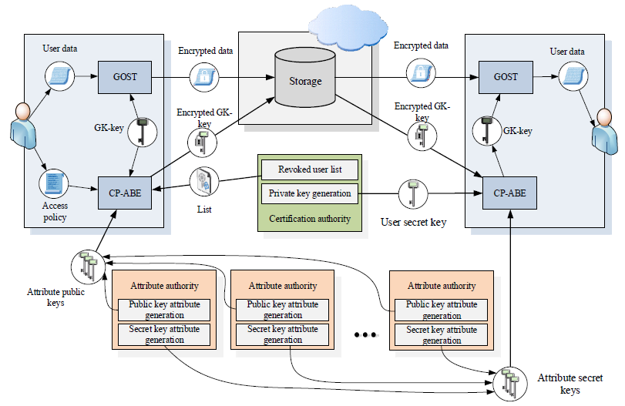
ARCHITECTURE DIAGRAM

Slide 8
SYSTEM REQUIREMENTS
HARDWARE REQUIREMENTS:
System : Pentium IV 2.4 GHz.
Hard Disk : 500 GB.
Monitor : 15 VGA Colour.
Mouse : Logitech.
RAM : 4 GB
SOFTWARE REQUIREMENTS:
Operating system : Windows 7/8/10.
Coding Language : Java
IDE : NetBeans 8.0.
JDK : JDK 1.8.
Database : MYSQL 10.0.

Slide 9
MODULES
CLOUD SERVICE PROVIDER
DATA USERS MODULE
PRIVATE CLOUD MODULE
SECURE DEDUPLICATION SYSTEM
ACCESS CONTROL SYSTEM

Slide 10
MODULE EXPLANATIONS
CLOUD SERVICE PROVIDER
Cloud Service Provider, This is an entity that provides a data storage service in public cloud. The S-CSP provides the data outsourcing service and stores data on behalf of the users. To reduce the storage cost, the S-CSP eliminates the storage of redundant data via deduplication and keeps only unique data. Assume that S-CSP is always online and has abundant storage capacity and computation power.
DATA USERS MODULE
A user is an entity that wants to outsource data storage to the S-CSP and access the data later. In a storage system supporting deduplication, the user only uploads unique data but does not upload any duplicate data to save the upload bandwidth, which may be owned by the same user or different users. In the authorized deduplication system, each user is issued a set of privileges in the setup of the system. Each file is protected with the convergent encryption key and privilege keys to realize the authorized deduplication with differential privileges.
PRIVATE CLOUD MODULE
Compared with the traditional deduplication architecture in cloud computing, this is a new entity introduced for facilitating user’s secure usage of cloud service. Specifically, since the computing resources at data user/owner side are restricted and the public cloud is not fully trusted in practice, private cloud is

Slide 11
MODULE EXPLANATIONS
able to provide data user/owner with an execution environment and infrastructure working as an interface between user and the public cloud. The private keys for the privileges are managed by the private cloud, who answers the file token requests from the users. The interface offered by the private cloud allows user to submit files and queries to be securely stored and computed respectively.
SECURE DEDUPLICATION SYSTEM
Consider several types of privacy we need protect, that enforceability of duplicate-check token: There are two types of adversaries, that is, external adversary and internal adversary. The external adversary can be viewed as an internal adversary without any privilege. CloudId query the corresponding table of the database, get the file name fileName, the MD5 message summary value MD5Value and other information corresponding to the data file, and download the file to the server by calling the corresponding getObjectToFile() method of the cloud storage service. If a user has privilege p, it requires that the adversary cannot forge and output a valid duplicate token with any other privilege p′ on any file F, where p does not match p′. Furthermore, it also requires that if the adversary does not make a request of token with its own privilege from private cloud server, it cannot forge and output a valid duplicate token with p on any F that has been queried.

Slide 12
MODULE EXPLANATIONS
ACCESS CONTROL SYSTEM
To develop an access control model based on blockchain transactions, storing data in untrusted storage, and implementation of attribute-based encryption-based smart contracts. We use attribute-based access control model. Erasure Code is a forward error correction technology. The application of erasure code originates from the error detection and correction in data transmission process in the field of communication transmission, and is gradually applied to the big data storage system. The most widely-used standard for attribute-based access control. This standard describes the necessary components of access control system, its purpose, interaction and using methods. It is expected that the system can be applicable for different data type, for example, multimedia information, electronic documents. To store this amount of data directly in the blockchain is not advisable, as increasing the number and increasing the size of the blocks, the complexity of increase multiple, which will primarily affect the cost of transactions. Therefore, data will be stored in cloud storage, wherein the information identifying the file, will only is available in the blockchain.

Slide 13
IMPLEMENTATION

Slide 14
SAMPLE SCREEN SHOTS

Slide 15
CONCLUSION

Slide 16
REFERENCES
Y.Z. ZHU, “Design and Consistency Evaluation of Distributed Coded Data Storage,” Tianjin University of Technology, 2019.
L. LU, “Research and Design of Hybrid Cloud Storage Architecture,” Beijing University of Posts and Telecommunications, 2019.
B. HUANG, “Highly Reliable Public Cloud Storage System in the Multi-Cloud,” Huazhong University of Science and Technology, 2020.

